Slide 1
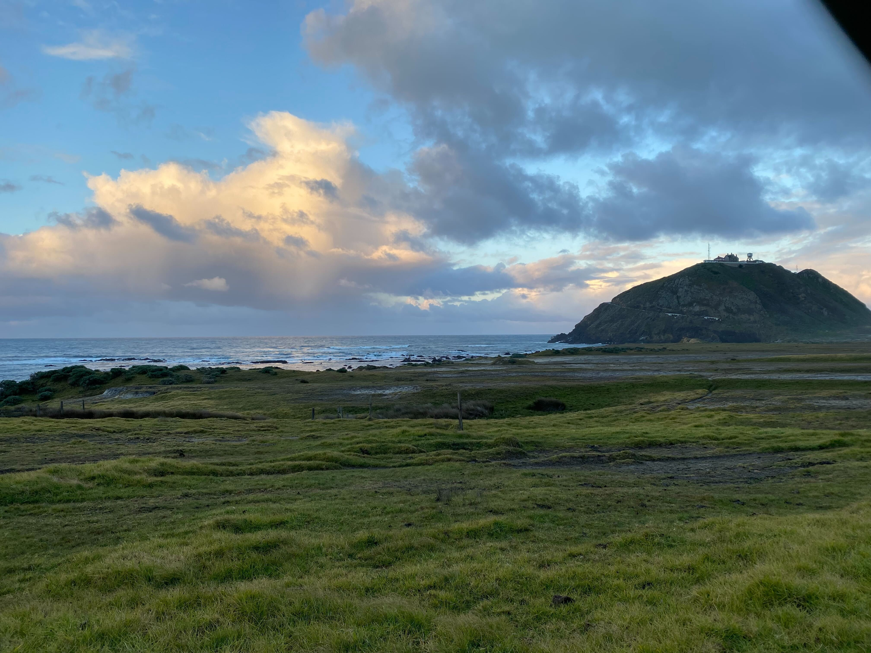
The CALifornia Investigation of Convection over Ocean
(CALICO)
Scott W. Powell (scott.powell@nps.edu) and LCDR Jessica Wasserman
Dept. of Meteorology, Naval Postgraduate School, Monterey, CA
2022 AGU Fall Meeting, A42G-6
Photo: Point Sur during CALICO, 5 Mar 2022, by Jake Mulholland
This work was supported by the Office of Naval Research Code 322 under grant N0001422WX01021.

Slide 2
All CALICO participants:
Sponsored by Office of Naval Research Code 322
NPS: Scott Powell (Lead PI), Daniel Bazemore, Jessica Wasserman, Mark Boothe, Anthony Bucholtz, Roy Woods
+ numerous students for launching weather balloons
+ thanks to Ryan Yamaguchi and Jesus Ruiz-Plancarte for helping with setup
+ Zivko Aeronautics for flying the plane
PSU: John Peters (Co-PI)
UND: Jake Mulholland
CSU: Bowen Pan
SJSU: Craig Clements, Kate Forrest
Stanford: Ipshita Dey, Laurel Regibeau-Rockett
NRL: Coastal remote sensing observations

Slide 3
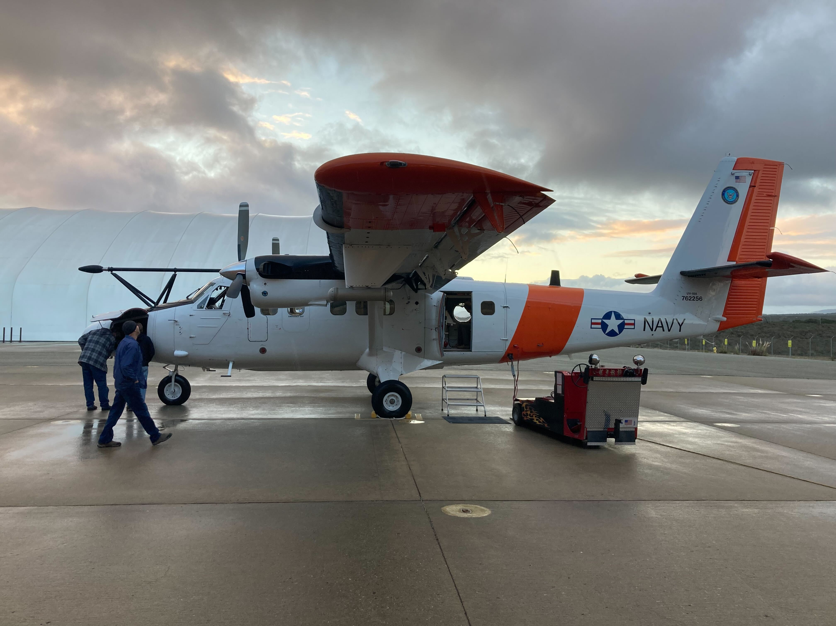
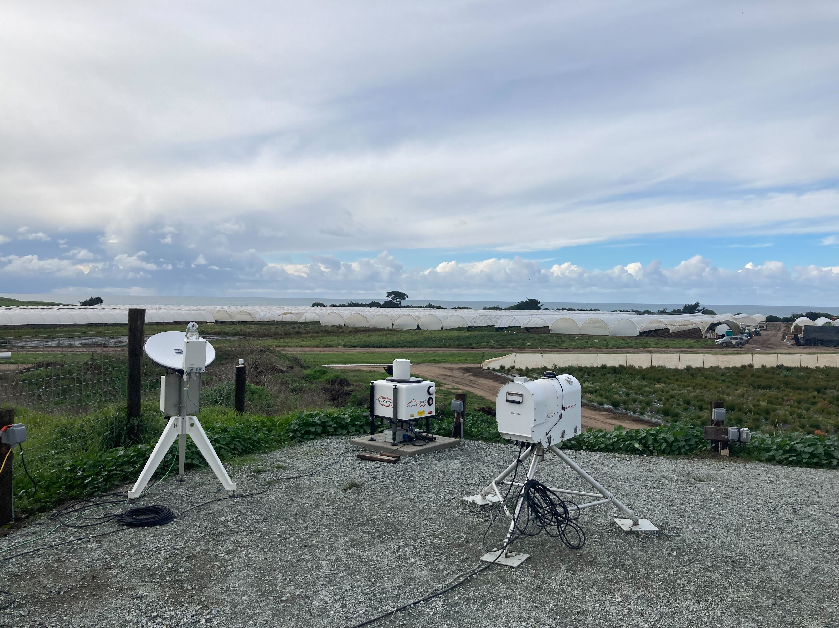
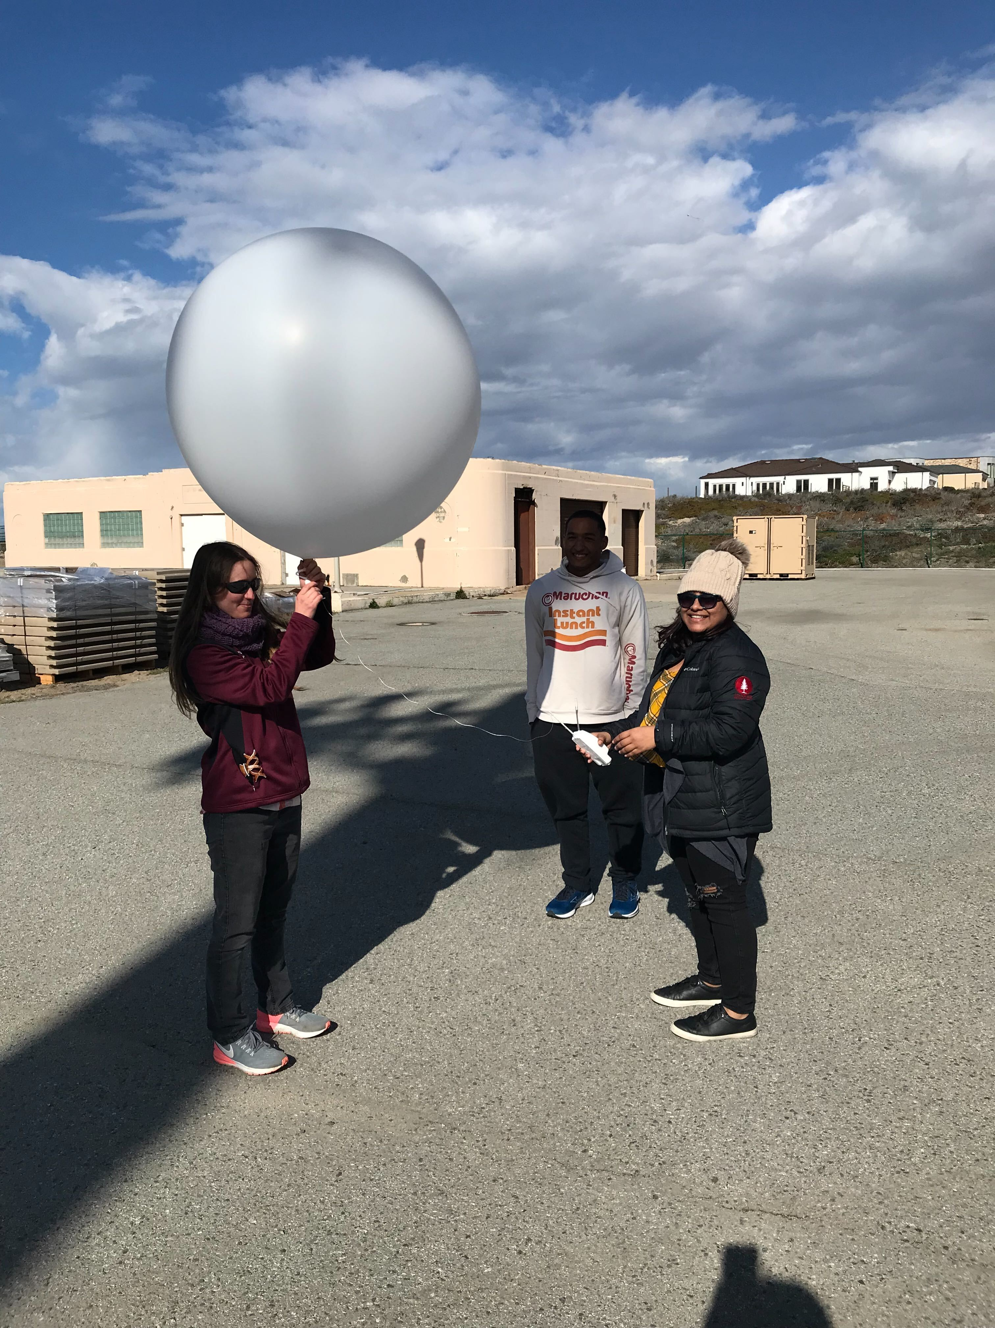
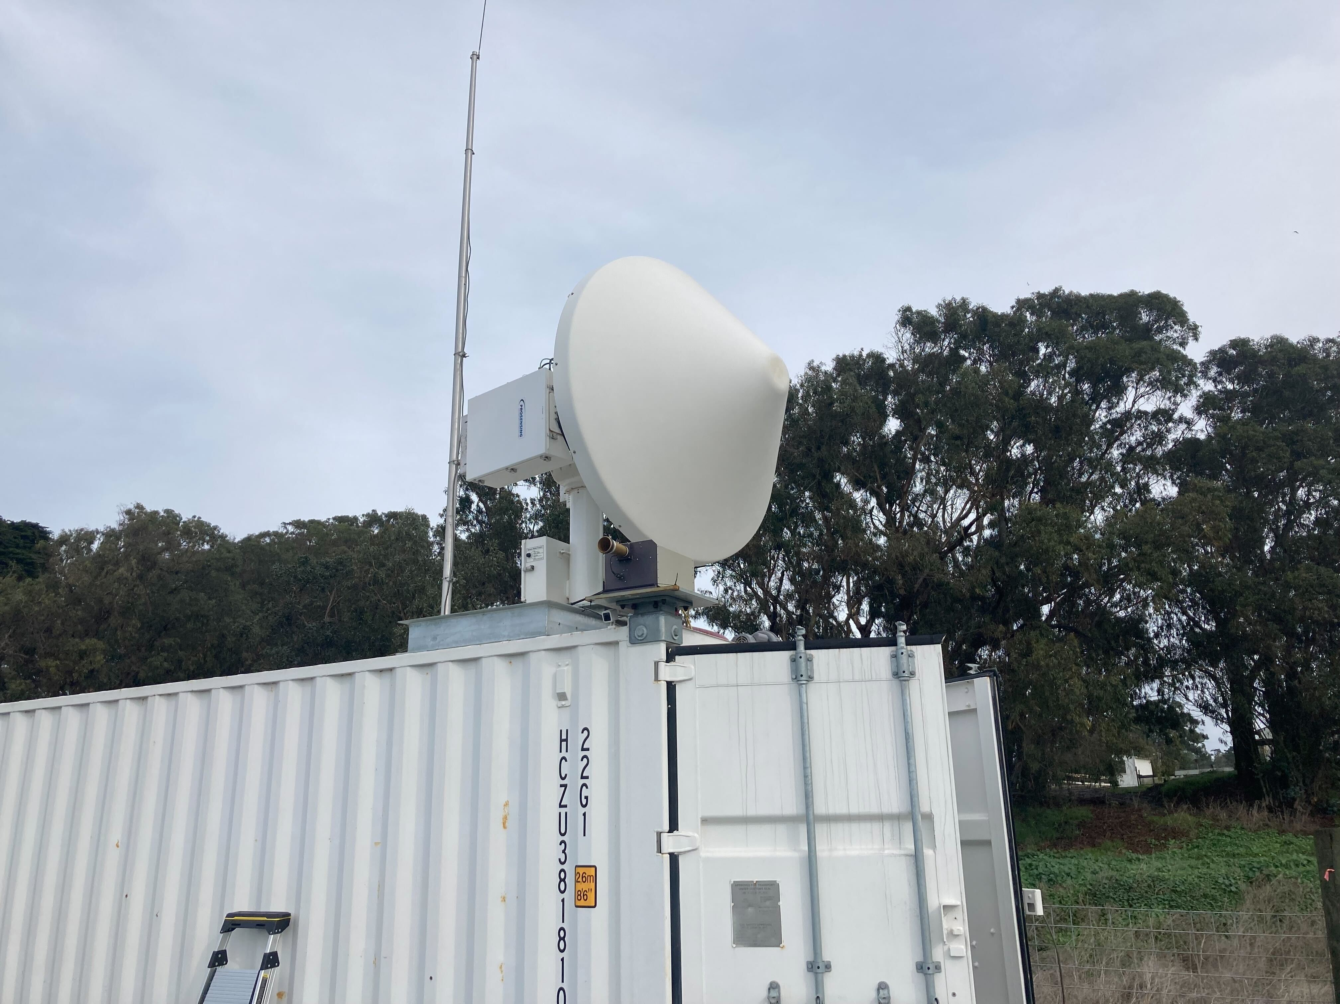
Overview of CALICO Observations
NPS Twin Otter
NRL-CEOBS
Rawinsondes
Three convective events:
22 February
5 March
19 March (weak shallow cumuli)

Slide 4
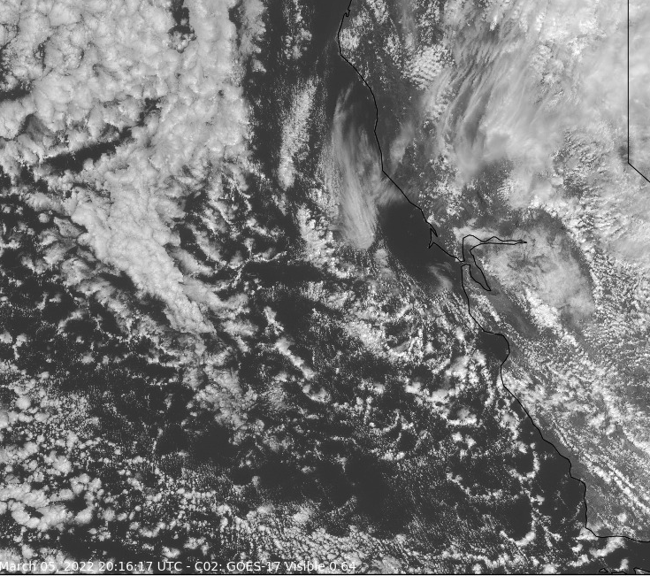
GOES-17 640 nm
2016 UTC
5 March 2022
Credit: SJSU

Slide 5
GOES-17 640 nm
2016 UTC
5 March 2022
Credit: SJSU
Flight pattern parallel to cloud motion vector
Flew mostly near cloud base
Some sub-cloud layer legs on 22 Feb

Slide 6
Experimental Objectives and Research Questions
What role does shear play in growth of convective updrafts via its impact on forces felt by updrafts?
How does “clustering” of convection “organized” by cold pools change the role of shear?
What controls what clouds and/or updrafts grow and those that do not?
BONUS: What is the total mass flux at cloud base in cold updrafts?

Slide 8
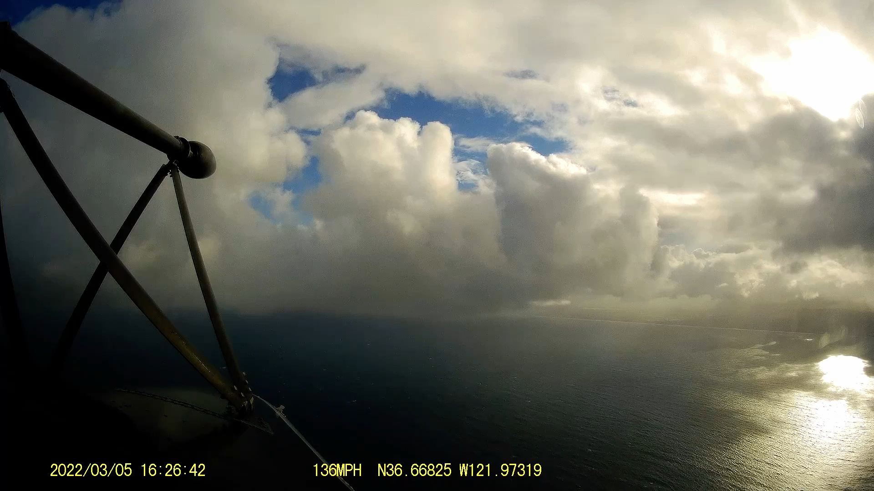

Slide 9
Warm Updrafts
Flight level: 800–900 m (near cloud base)
Temperature
Vertical Velocity
Temperature
Vertical Velocity
Mission Time
Mission Time
Mission Time

Slide 10
Warm Updrafts
Flight level: 800–900 m (near cloud base)
Temperature
Vertical Velocity
Temperature
Vertical Velocity
Mission Time
Mission Time
Mission Time

Slide 11
Warm Updrafts
Cold Updrafts
Flight level: 800–900 m (near cloud base)
Temperature
Vertical Velocity
Temperature
Vertical Velocity
Temperature
Vertical Velocity
Temperature
Vertical Velocity
Mission Time
Mission Time

Slide 12
Warm Updrafts
Cold Updrafts
Flight level: 800–900 m (near cloud base)
Temperature
Vertical Velocity
Temperature
Vertical Velocity
Temperature
Vertical Velocity
Temperature
Vertical Velocity
Temperature
Vertical Velocity
Mission Time
15–25% of observed updrafts were cold regardless of the length of the cross-section sampled.
Mission Time
Mission Time

Slide 13
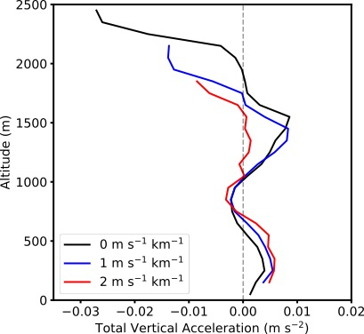
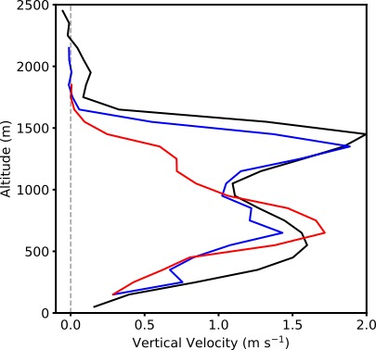
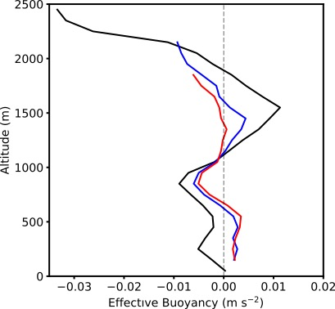
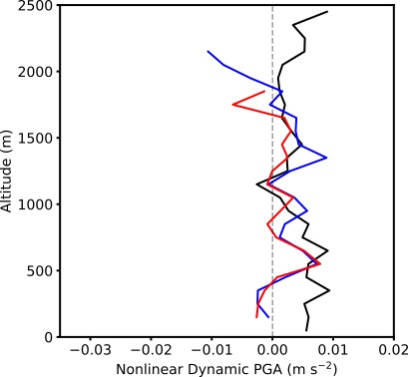
In an LES using a real CALICO sounding as initial conditions, what is the forcing on a single updraft forced by a warm bubble below the LCL?
Dw/Dt

Slide 14
Dw/Dt
Vertical velocity
(Effective) buoyancy dominates the vertical acceleration in single isolated updrafts in LES.
Effective buoyancy
Dynamic NL PGA

Slide 15
Conclusions
Most convection observed during postfrontal Pacific convective events was cold pool driven.
Roughly 15–25% of observed and simulated convective elements in postfrontal convection were cooler than immediately environment. These updrafts were negatively buoyant even containing the virtual correction for moisture.
In cold updrafts, the pressure gradient acceleration was directed upward to make total Dw/Dt positive.
In idealized isolated convection with CALICO sounding, effective buoyancy dominates total vertical acceleration in updrafts and on average becomes near zero to slightly negative above cloud base for wind shear similar to that observed.
Much work remains to done with this dataset!

Slide 16
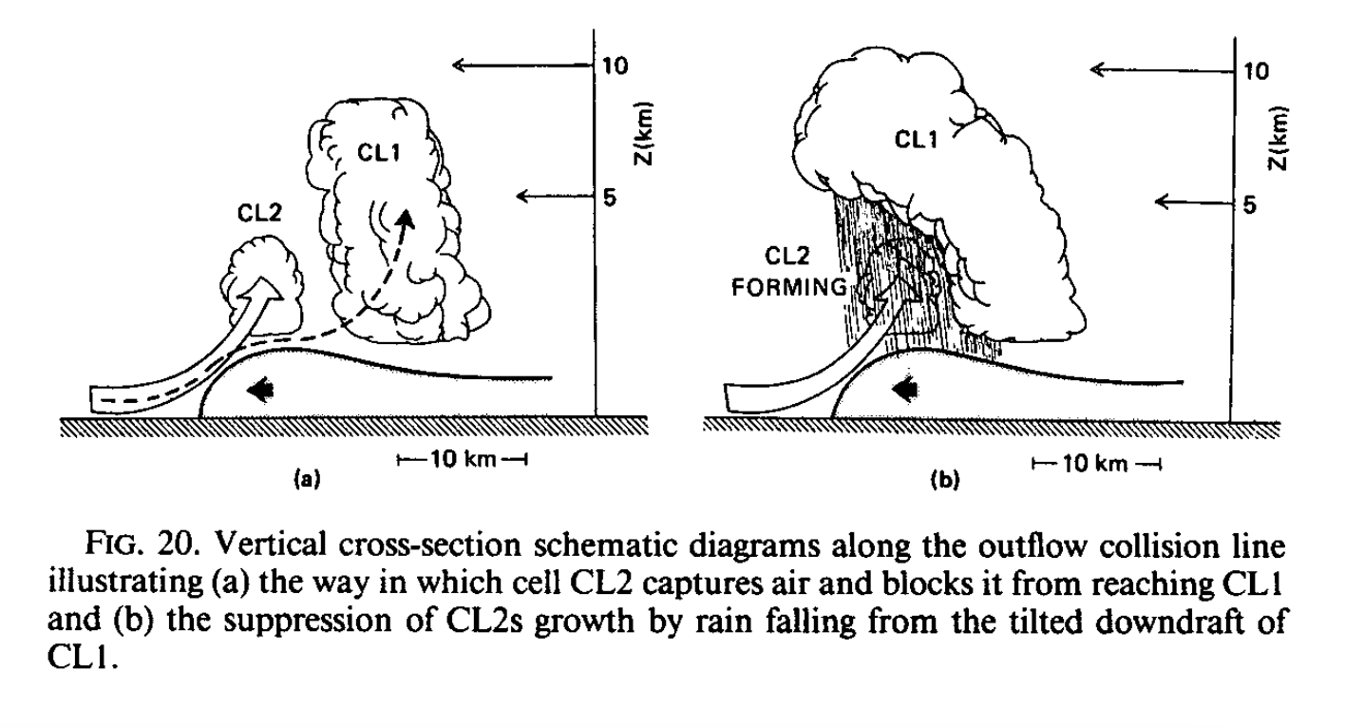
Droegemeier and Wilhelmson (1985)

Slide 17
Are there cold updrafts in LES of CALICO convection?

Slide 18
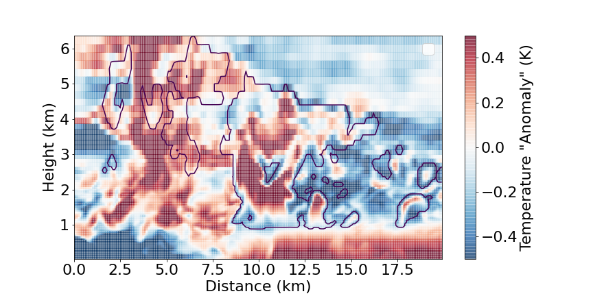
Are there cold updrafts in LES of CALICO convection?
Potential Temperature “Anomaly”

Slide 19
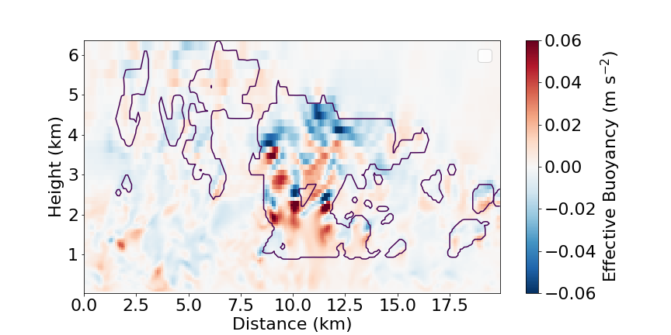
Are there cold updrafts in LES of CALICO convection?
Dw/Dt

Slide 20
Are there cold updrafts in LES of CALICO convection?
Dw/Dt
Depending on updraft size, 15–25% of updrafts in CM1 were cold.

